Slide 1

Olist Store: Customer Experience, Sales & Delivery Performance Analysis
Our Team
Miles
Keerit
Chandrika
Danai
Notes:
Welcome

Slide 2
Purpose of Olist Store Process
Customer purchases a product from Olist Store
Seller is notified to fulfil the order
Product is delivered (or delivery date is reached)
Customer receives a satisfaction survey
Customer may leave a score and comments
Key question: How do delivery performance and customer feedback relate to customer satisfaction and future sales?

Slide 3
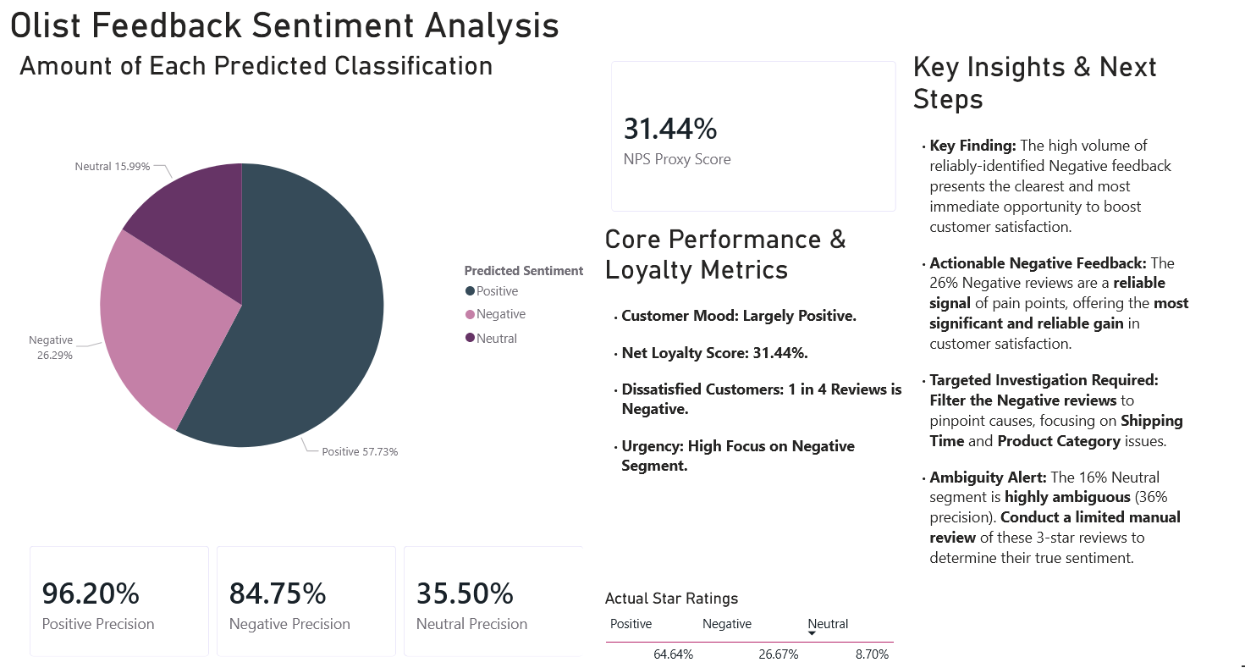
Notes:
1. Introduction (Overall Picture)
Goal: "This slide presents the results of the Olist Feedback Sentiment Analysis, classifying all customer reviews to give us a clear, data-driven look at customer mood and where we need to focus our efforts."
Key Takeaway (Upfront): "While the overall customer mood is largely Positive (57.73%), we have a significant, reliable, and actionable segment of Negative feedback (26.29%) that must be our immediate priority."
2. Core Performance & Loyalty Metrics
NPS Proxy Score: "Our current Net Loyalty Score (or NPS Proxy) stands at 31.44%. Our goal is to use this analysis to drive this score higher."
Dissatisfaction Rate: "The data shows that roughly 1 in every 4 reviews is Negative. This high volume indicates widespread pain points that, if fixed, will have a major impact."
Urgency: "The message is clear: our highest focus must be on quickly and effectively addressing the Negative Segment."
3. Sentiment Distribution & Model Reliability
Positive Segment: "The majority is positive, and our model is highly confident, with 96.20% Positive Precision."
Negative Segment (The Focus): "We've reliably identified 26.29% of reviews as negative. Crucially, our model has an 84.75% Negative Precision, meaning this is a highly reliable signal of real customer pain."
Neutral Segment (The Ambiguity): "The 15.99% Neutral segment is our wildcard. Note the low Neutral Precision of 35.50%. This segment is highly ambiguous, and we should not ignore it."
4. Key Insights & Next Steps (The Action Plan)
The Opportunity: "The high volume of reliably-identified negative feedback is our single largest, clearest, andmost immediate opportunity to boost customer satisfaction and loyalty. We know what to fix."
Targeted Investigation: "We cannot afford a broad investigation. The data points us to filter these negative reviews and immediately focus our resources on two key areas: Shipping Time and Product Category issues."
Addressing Ambiguity: "To fully understand our customer base, we need to resolve the Neutral ambiguity. We recommend a limited, manual review of those 3-star reviews to ensure we aren't misclassifying detractors as neutral."
Closing Statement: "In summary, the next step is clear: we must act immediately on the high-precision negative signals to target Shipping Time and Product Category issues, which will be the fastest route to improving our Net Loyalty Score."

Slide 4
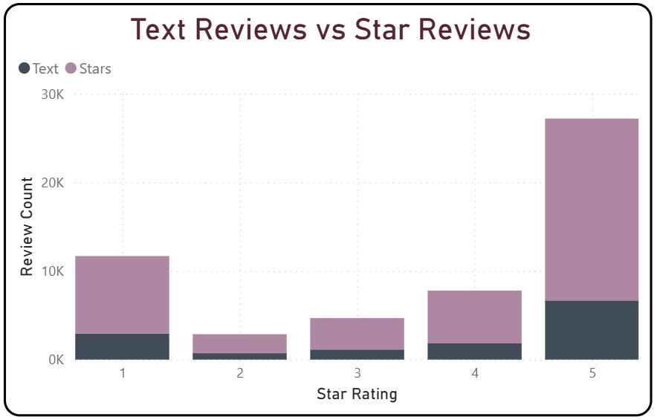
Review Types
Happy customers and customers with complaints leave the most reviews
Customers are much more likely to leave a star review than text
Consider offering
vouchers or special promotions to those who leave text reviews

Slide 5
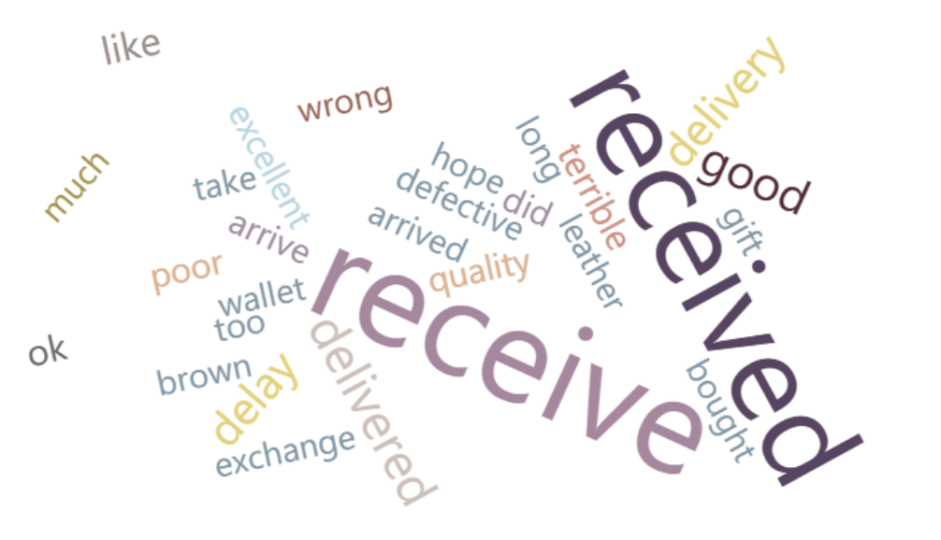
Negative Reviews
Words like received, delay and arrived appear most often
Our analysis would suggest issues with customers receiving the wrong product
Would like to bring you more detail on delivery location but we would need more time

Slide 6
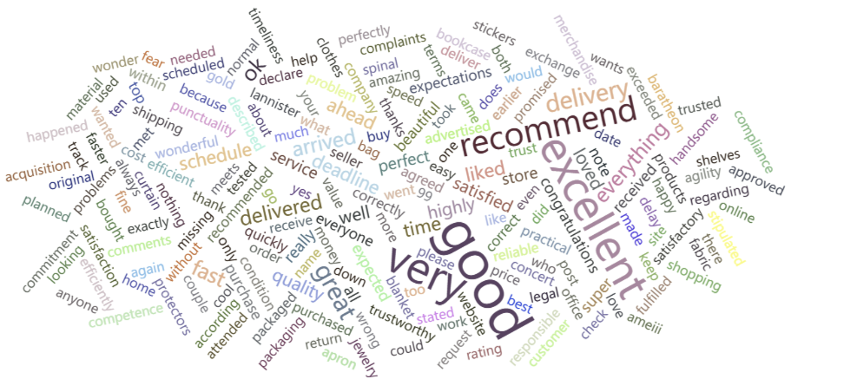
Positive Reviews
Words like recommend, excellent and good are most frequent
Customers who are happy tend to leave more verbose reviews

Slide 7
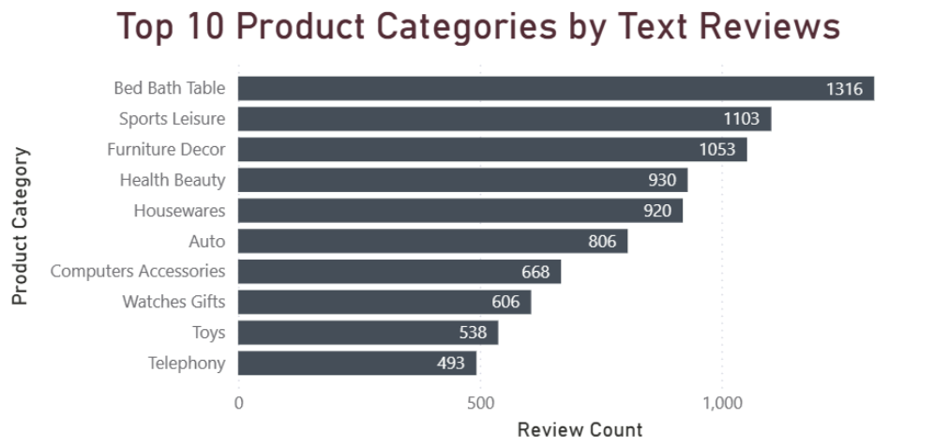
Most Reviewed Products
Customers who purchased from the top 5 product categories left only positive or neutral text reviews.
Further reinforces the idea that happy customers leave the most reviews

Slide 8
Sales Forecast & Action Plan Predicting the Next Six Months of Sales
Research Question: Future Sales Trend: How much are sales predicted to change over the next six months (Sept 2018 to Feb 2019)? Performance Drivers: Which product categories are causing our total sales to go up or down?

Slide 9
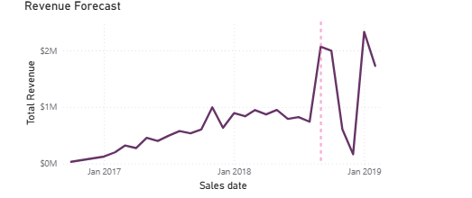
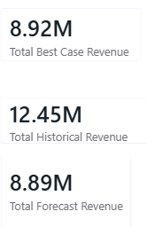
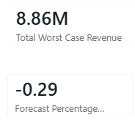
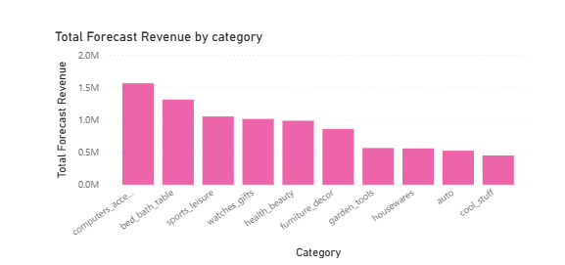
Visuals from Report & Key Results
The most critical result is the 29% decline in sales performance. This figure is the exact mathematical measure of the severe change in sales rate.
The line graph is the proof. It shows a stable historical period immediately followed by a sharp drop in the future sales trend. This visual drop is what the -29% shows.
The bar chart confirms the decline which is caused by the failure of few specific product categories: housewares, auto, and cool stuffs.

Slide 10
Strategic Action Plan
Action 1: Investment Priority | We must immediately invest more money in the computers accessories group. This is the only segment strong enough to maximize revenue and offset the predicted losses.
Action 2: Fix the Problem | We need to start an urgent investigation into the failing groups (housewares, auto, and cool stuffs). We must quickly decide if we can fix them or if we need to stop selling them completely to protect profits.

Slide 11

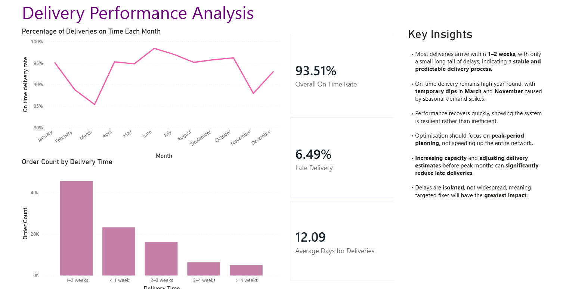

Slide 12
In Summary
Delivery performance is strong and reliable, with most delays occurring during peak demand periods, indicating that targeted peak-season planning and focused interventions on isolated late deliveries will deliver the greatest improvement.
Customer feedback depth is limited; incentivising customers to leave written reviews through vouchers or special offers would improve insight quality and sentiment analysis accuracy.
Negative sentiment requires immediate action: prioritising investigation of the 26% of reliable negative reviews, particularly those linked to shipping delays and product specific issues, presents the strongest opportunity to improve customer satisfaction and Net Loyalty Score.
Sales performance is declining, with a 29% projected revenue drop, especially in the housewares, auto, and cool stuff categories, highlighting an urgent need for targeted category-level recovery strategies.

